Slide 1
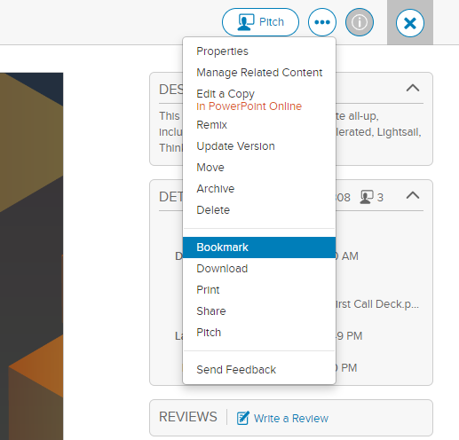
Welcome to the AI and ML Category First Call Deck. Please review and rate this presentation:
Click on the star rating below in Highspot or presentation mode.
Subscribe to this deck!
Please use the “Bookmark” function in Highspot to be alerted to of updates. Hide this slide before presenting.
DO NOT PRESENT THIS SLIDE

Slide 2
SPEAKER GUIDANCE—REMOVE THIS SLIDE
This deck was created for a general audience, pick and choose relevant slides from the appendix including which deep-dive service slides to include based on use case
This deck has chapters, which include a high-level AWS technology pitch for 100-level shorter conversations and 200-level deeper-dive slides, for even more, you can get deeper content on service-level first call decks, comparison docs: Wisdom
For industry-specific first call decks visit the industry Wisdom page
Find additional customer references: Top ML references
Reach out to your regional AWS AI/ML Specialist: and include a link to this wiki page: https://w.amazon.com/bin/view/AWS-Sales-BD/AWS-AIML/
Have content suggestions for this deck? Reach out to rebecwol@amazon.com
DO NOT PRESENT THIS SLIDE

Slide 3
SPEAKER GUIDANCE—REMOVE THIS SLIDE
100-Level Introduction to AWS Machine Learning:
The following set of slides are meant for a 15-minute introduction conversation to both machine learning and AWS’s ML approach and technology
These slides should be used for an initial conversation with a customer or any conversation with a non-technical leader
Select the use case slides and customer references in the appendix depending on your customer priorities
DO NOT PRESENT THIS SLIDE

Slide 4
Guidance for implementing AI Use Cases
Position SageMaker when the company has ML expertise and ML practitioners
Position Canvas when talking to business analysts that want to build their own models for predictive analytics
Position AI Services when the customer wants to develop in-house, has no ML skills, or has ML skills but has time-to-market constraints
Position AWS AI/ML Solutions as solution accelerators using AI Services
Position ML Solutions Lab when they want to work hand in hand with AWS to develop a proof of concept
Position partner solutions when they need a turnkey solution
Position ProServ or a partner when they want to outsource the development
DO NOT PRESENT THIS SLIDE

Slide 5
Introduction to machine learning with AWS
Notes:
This is a first call deck for machine learning at AWS.

Slide 6
The reach of ML is growing
INCREASED SPENDING
By 2026, global spending on artificial intelligence will reach $300 billion growing 4.2 faster than average IT spend
IDC
AI ACROSS SEVERAL BUSINESS UNITS
Gartner survey reveals 80% of executives think automation can be applied to any business decision
Gartner
AI IS CRITICAL
TO SUCCESS
94% of business leaders surveyed say AI is critical to their success
Deloitte
“IDC Press Release, Worldwide Spending on AI-Centric Systems Will Pass $300 Billion by 2026, According to IDC, September 2022,” https://www.idc.com/getdoc.jsp?containerId=prUS49670322
Gartner, Press Release https://bit.ly/3is16a2
Deloitte, “State of AI in the Enterprise,” https://bit.ly/3XiNOLR
Notes:
Machine learning went from being an aspirational technology to mainstream extremely fast.
For a long time, the technology was limited to a few major tech companies and hard-core academic researchers.
However, things began to change when cloud computing entered the mainstream.
After that, compute power and data became more available, and quite literally, machine learning is now making an impact across every industry (such as finance, retail, fashion, real estate, healthcare, and so on.).
It’s moving from the periphery to a core part of every business and industry.

Slide 7
What is it?
Artificial intelligence (AI)
Any technique that enables computers to mimic human intelligence using logic, if-then statements, and machine learning
Machine learning (ML)
A subset of AI that uses machines to search for patterns in data to build logic models automatically
Deep learning (DL)
A subset of ML composed of deeply multi-layered neural networks that perform tasks like speech and image recognition
Reinforcement learning (RL)
Reinforcement learning trains models by using a reward function of a desired outcome
Notes:
So what is AI?
AI is a way to describe any system that can replicate tasks that previously required human intelligence
Most AI use cases are looking for a probabilistic outcome—making a prediction or decision with a high degree of certainty, similar to human judgement.
Almost all AI systems today are created using machine learning. Machine learning uses large amounts of data to create and validate decision logic, which is known as a model.
Deep learning is a type of machine learning that uses a technique known as deep neural networks. These systems replicate how the human brain functions, which allows those systems to address more complex use cases than was previously possible.
Finally, Reinforcement learning trains models by using a reward function of a desired outcome
It is used for example for autonomous vehicles and usually require of simulation tools to train the model

Slide 8

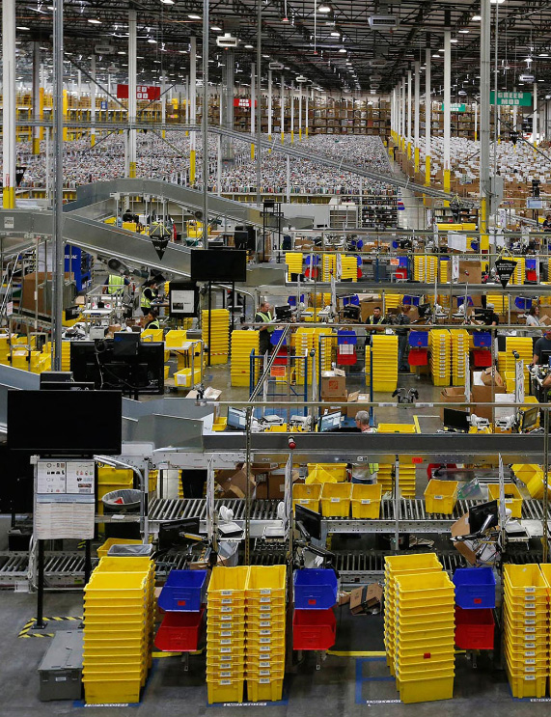
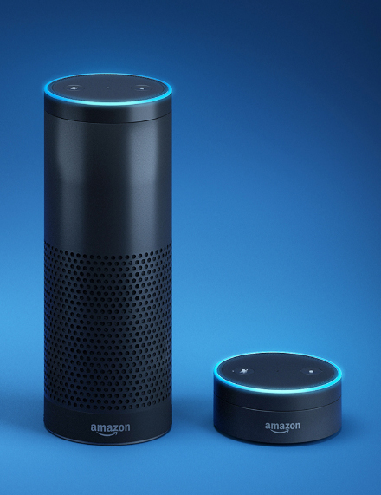
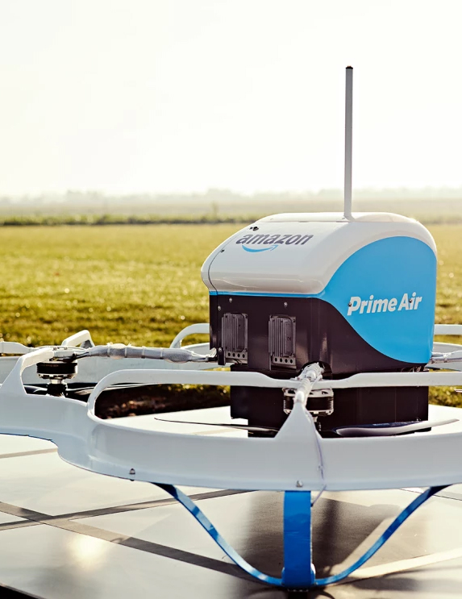
Amazon machine learning innovation at scale
4,000 products per minute sold on Amazon.com
1.6 million packages every day
Billions of Alexa interactions each week
First Prime Air delivery on December 7, 2016
Notes:
ML is an integral part of Amazon. We have been applying ML in areas such as personalization and supply chain for more than 20 years.
We’ve also improved that original personalization model significantly over time and moved it to other products, such as Amazon Prime.
We use ML throughout our fulfillment process, including developing a forecast system that can predict the appropriate amount of demand for each product we sell worldwide to deliver on customer expectations for convenience, cost, and delivery speed.
We’ve developed natural language processing technology to give customers an entirely new way to interact with technology through Alexa.
We’ve also developed groundbreaking technology, such as autonomous flight through Prime Air drones and robotics in our fulfillment center to get packages to customers faster.
Almost every department at Amazon has been touched by machine learning.

Slide 9




Enhance customer experience
Better and faster decision-making
Improve business operations
New products and services
Notes:
At AWS, we’re seeing a tipping point, where AI/ML in the enterprise is addressing use cases that create measurable results, in these 4 categories: enhancing customer experiences, enabling employees and organizations to make better and faster decisions, improving business operations while reducing cost, or create completely new products and services powered by AI and ML.

Slide 10
Contact center intelligence
Intelligent search
Intelligent document processing
Chatbots and virtual assistants
Forecasting
Content moderation
Predictive Maintenance
Personalization
Lead scoring
New use cases
Machine translation
Identity verification
Churn prediction
MLOps
Fraud prevention
Coding & DevOps
Enhance customer experience
Better and faster decision-making
Improve business operations
New products and services
Notes:
Customer experience is being transformed via capabilities such as chatbots, virtual assistants, intelligent contact centers, personalization, or content moderation
AI/ML is helping companies make better and faster decisions by providing intelligent search capabilities, predictive analytics like forecasting, or by detecting anomalies in data and finding the root cause
Business operations are being improved with intelligent document processing, sophisticated demand planning, predictive maintenance, quality control and visual inspection, or applying AI to DevOps
Finally, AI/ML is helping companies create completely new products, services and business models powered by AI/ML to innovate and gain competitive advantage.

Slide 11





Healthcare & life sciences
Industrial & manufacturing
Financial services
Retail
Media & entertainment
Reduce costs, improve patient outcomes, and enable the discovery and manufacturing of new drugs
Implement predictive maintenance, improve workplace safety, automate visual inspection, and optimize supply chains
Detect fraud, process documents faster, personalize recommendations, and perform credit decisioning
Personalize product recommendations, forecast demand, and predict fraud
Accelerate content creation and curation, increase customer engagement, and improve monetization
Notes:
And while we see machine learning happening everywhere, there are specific industries that are meaningfully impacted by machine learning.

Slide 12

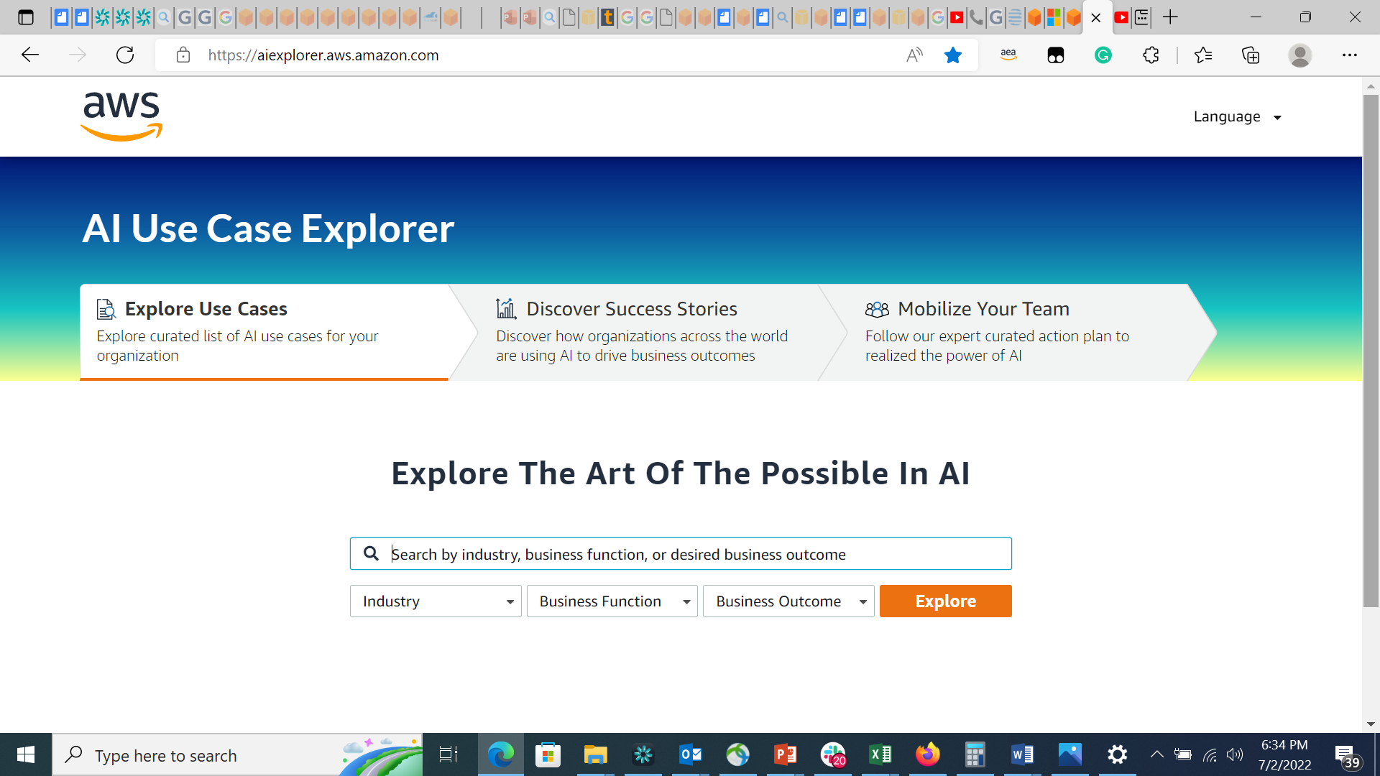

NEW!
aiexplorer.aws.amazon.com
AI Use Case Explorer
Easily find the most relevant AI use cases with related content and guidance to make them real
Notes:
With the AI Use case Explorer you can find the most relevant AI use cases for you with related content and guidance to make them real
Our tool offers three main features:
1) Explore curated list of AI use cases for your organization
2) Discover how organizations across the world are using AI to drive business outcomes
3) Follow our expert-curated action plan to realize the power of AI

Slide 13
With the growth of AI comes the recognition that we must all use it responsibly
Our commitment to develop AI and machine learning in a responsible way is integral to our approach
Transform responsible AI from theory to practice
Integrate responsible AI into the end-to-end ML lifecycle
Nurture and educate a more diverse generation of leaders in ML
Advance the science behind responsible AI
Notes:
With the growth of AI, comes the recognition that we must all use it responsibly. We define responsible AI as having 6 key dimensions including: fairness, explainability, robustness, governance, transparency and privacy and security.
Our commitment to develop AI and machine learning in a responsible way is integral to our approach.
First we are helping our customers transform responsible AI from theory into practice. We focus on helping our customers untangle the complex questions that surround dimensions such as fairness and explainability.
Second, we take a holistic approach to building our AI services responsibly. For AWS, responsible AI is an integral part of the entire machine learning lifecycle including design and development, deployment, and ongoing use.
Third, we take a people-centric approach that starts with education and doing our part to educate and build the next generation of developers and data scientists in AI with the AI and ML Scholarship Program and Machine learning University.
Fourth, we are constantly innovating and iterating. We are committed to improving, refining, and expanding our approach to responsible AI. Responsible AI is an active area of research and development and we are working to advance the science behind it
Transition: We are excited to work hand in hand with our customers to build and use AI more responsibly. Our customers are delivering incredible innovation with AI across industries and use cases

Slide 14



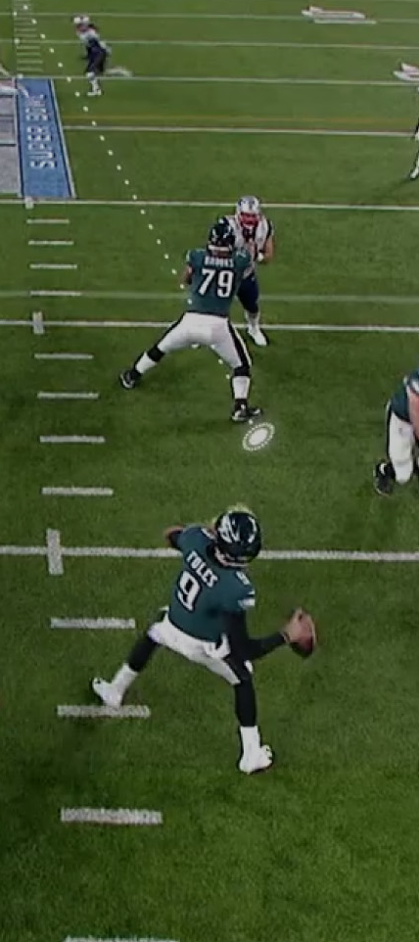




Notes:
Let’s look at just a few of those customers
In customer experience, Intuit has built forecasting capabilities to predict call center demand on a particular day or time so that customer service agents are adequately staffed.
In manufacturing, 3M uses our Intelligent search solution Amazon Kendra, to help scientists find the information they need by handling natural language queries quickly and accurately.
In manufacturing too, KOCH AS & ENERGY SOLUTIONS is improving asset performance by using Amazon Monitron and Amazon Lookout for Equipment, to detect abnormal equipment behavior and enable predictive maintenance
And in sports, we’ve been working with the NFL to create Next Gen Stats that engage fans by combining old and new data to reveal insights about game dynamics. We have now developed over 20 unique Next Gen Stats that are used on screen during games in real time—by broadcasters and partners, for fans online, and more. The most exciting stats use predictive machine learning models built on Amazon SageMaker to highlight the players’ athleticism in brand-new ways, with more to come.
Transition: These are just a few examples of how AWS customers are using AI/ML to accelerate their digital transformation

Slide 15












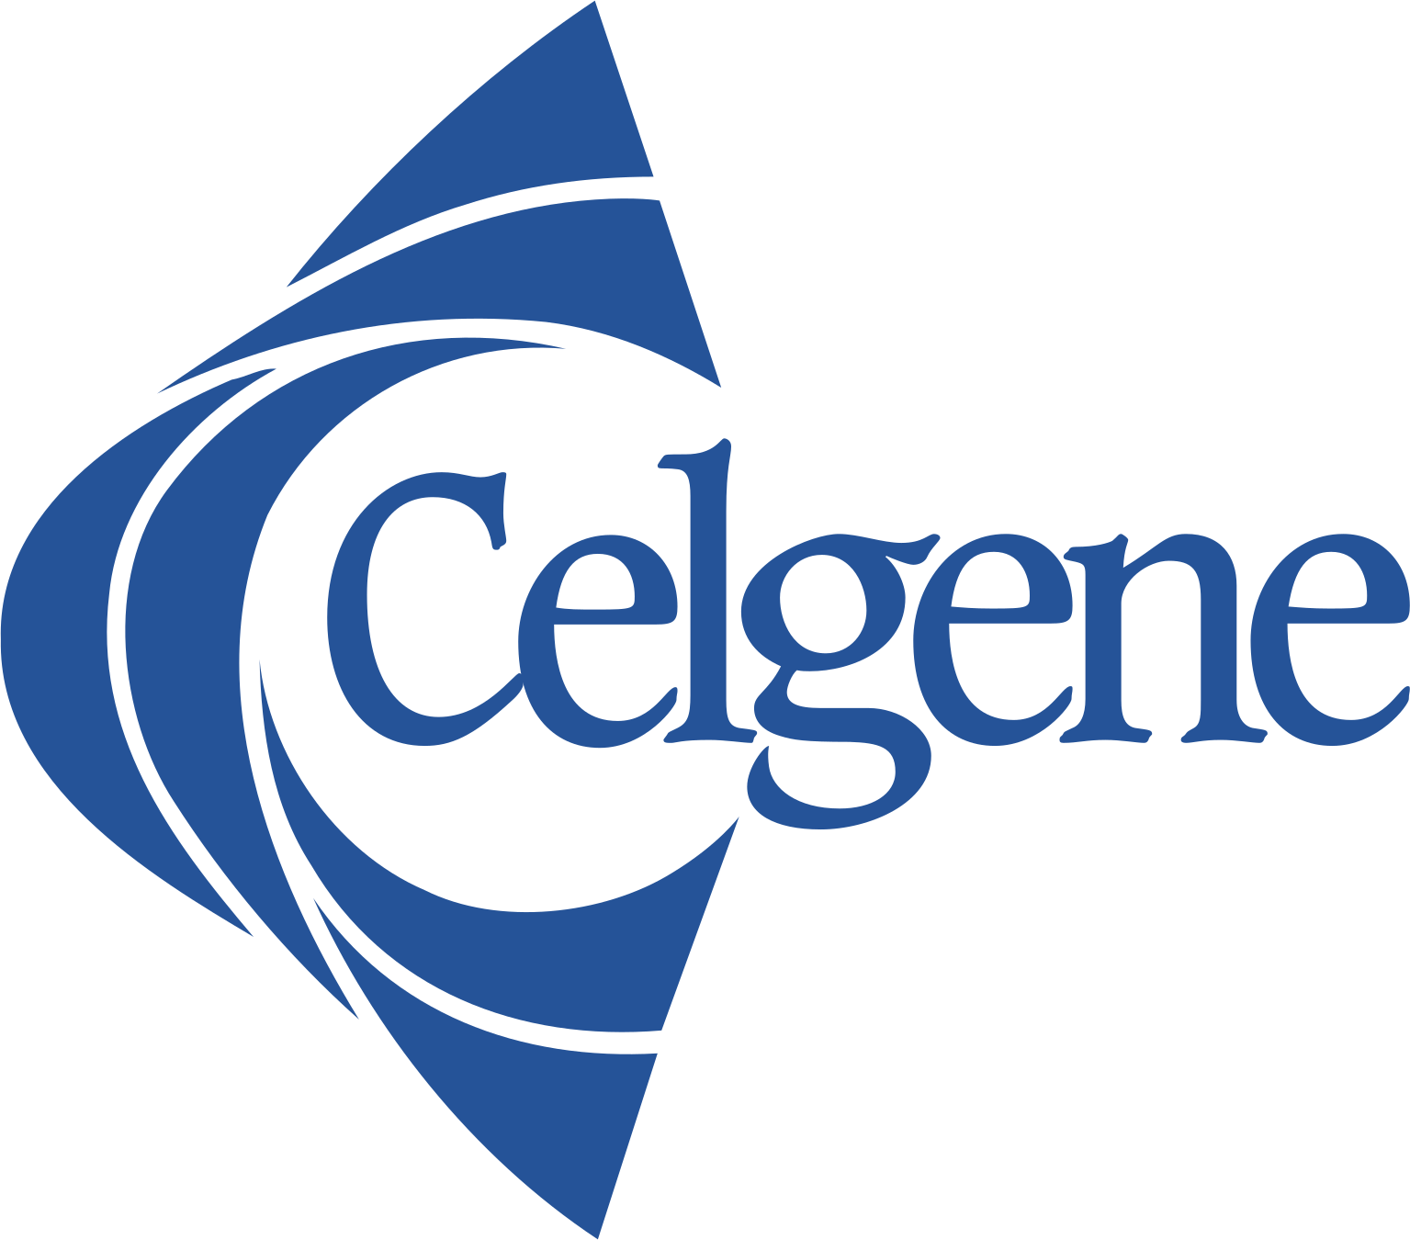



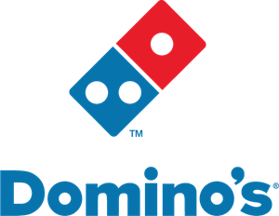




























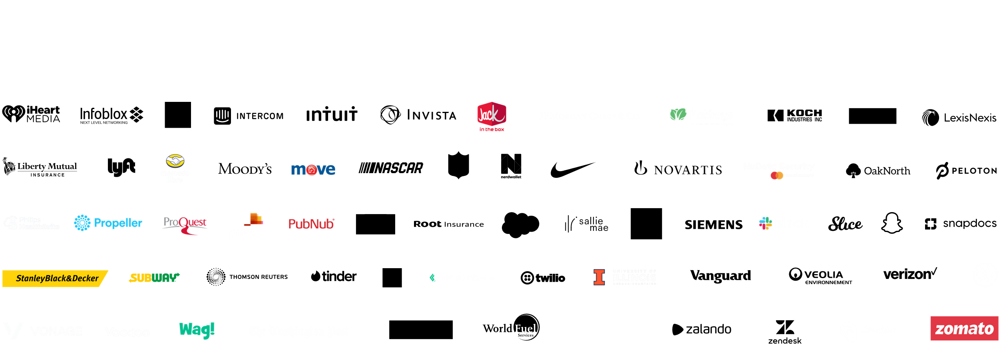








100,000+ customers use AWS for machine learning
Notes:
More than 100,000 customers use AWS for machine learning today
However, even with the increasing adoption of machine learning and all the hype associated with the technology, it’s still in its infancy.
We are just beginning to see the impact ML can have across industries and geographies.

Slide 16
The AWS AI/ML stack
Broadest and most complete set of machine learning capabilities
AI SERVICES
SPECIALIZED
BUSINESS PROCESSES
Amazon Personalize
Amazon Forecast
Amazon Fraud Detector
Amazon Lookout for Metrics
SEARCH
Amazon Kendra
CONVERSATION
Amazon Lex
Amazon Transcribe Call Analytics
Contact Lens
Voice ID
CODE + DEVOPS
Amazon CodeGuru
Amazon CodeWhisperer
Amazon DevOps Guru
INDUSTRIAL
Amazon Monitron
Amazon Lookout for Equipment
Amazon Lookout for Vision
HEALTH
Amazon HealthLake
Amazon Comprehend Medical
Amazon Transcribe Medical
Amazon Omics
CORE
TEXT
Amazon Translate Amazon Comprehend
SPEECH
Amazon Polly Amazon Transcribe
VISION
Amazon Textract Amazon Rekognition AWS Panorama
AMAZON SAGEMAKER
STUDIO IDE
CANVAS
No-code ML for business analysts
STUDIO LAB
Learn ML
GROUND TRUTH
Label data
Train models
Deploy in production
EDGE MANAGER
Manage edge devices
Prepare data
Geospatial
ML
Build with notebooks
Store features
Tune parameters
Manage and monitor
CI/CD | GOVERNANCE | RESPONSIBLE ML
ML FRAMEWORKS & INFRASTRUCTURE
PyTorch, Apache MXNet, TensorFlow
Amazon EC2
CPUs
GPUs
AWS Inferentia
AWS Trainium
Habana Gaudi
FPGA
Notes:
At AWS, we’re innovating on behalf of our customers to deliver the broadest and deepest set of machine learning capabilities for builders of all levels of expertise, removing the undifferentiated heavy lifting so that our customers can move faster.
The stack can be used by expert practitioners that want to develop in the framework of their choice, data scientists that want to use the end-to-end capabilities of SageMaker, Business Analysts that can build their own model using Canvas, or application developers with no ML skills that can add intelligence to their applications using our pre-trained models offered as managed services: The AWS AI Services.

Slide 17
Innovate faster with the most comprehensive set of AI/ML services
AWS ADVANTAGE
AI powered use cases
Hundreds of pre-built algorithms, models, and solutions for common use cases and industries
Faster time to value with 23 pre-trained AI Services
Democratize access to ML
Empower any business analyst to make predictions without writing code with Amazon SageMaker
AI Services to easily add AI capabilities to your applications, no ML skills required
Scale ML
Build, train, and deploy ML models for any use case with Amazon SageMaker
Harness the exponential growth of ML models with foundation models on AWS
Grow ML skills
Learn more with AWS Training, AWS DeepRacer, AI & ML Scholarship Program, and AWS Machine Learning University
Accelerate your journey with AWS ML Embark Program or Amazon ML Solutions Lab
Notes:
With AWS you can innovate faster with the most comprehensive set of AI/ML services
Let’s talk about four key areas where AWS is helping to deliver that innovation
First, AWS enables AI powered use cases with hundreds of pre-built algorithms, models, and solutions for common use cases and industries. And delivers faster time to value with 23 pre-trained services, like Amazon Personalize, Amazon Kendra, and Amazon Monitron
Second, at AWS we are working to democratize access to ML and make ML accessible to more people. With Amazon SageMaker Canvas, empower any business analyst to make predictions without writing any code. And with AWS AI services you can easily add AI capabilities to your applications, no ML skills required.
Third, you can easily scale ML with AWS. Amazon SageMaker allows you to build, train, and deploy ML models for any use case. And as we continue to see the exponential increase in the sophistication of ML models with an increasing number of parameters, you can build your own or access open source foundational models on AWS through Amazon SageMaker.
And last, we are committed to helping you grow ML skills at your organization and educating the next generation of ML developers with a whole host of resources from AWS Training to AWS DeepRacer to our AI & ML Scholarship Program and AWS Machine Learning University. You can also further accelerate your journey with AWS ML Embark and Amazon ML Solutions Lab.
Amazon has been investing in and using ML for the last 20 years (for recommendations, personalization, Alexa, and more) and has some of the most sophisticated ML deployments in production. We have helped more than 100,000 customers achieve ML success.

Slide 18





Building an end-to-end data strategy
Store and query
Integrate
Act
FOR APPLICATIONS
FOR ANALYTICS AND MACHINE LEARNING
ANALYTICS
Data Warehouse
Amazon Aurora
Amazon Redshift
Amazon EMR
PEOPLE
Data sources
Amazon Redshift
APPS
Data Lake
DEVICES
IOT/DEVICES
AWS Glue
MACHINE LEARNING & ARTIFICIAL INTELLIGENCE
APP/LOGS
Amazon DynamoDB
BUSINESS INTELLIGENCE
Amazon S3
THIRD-PARTY DATA
Amazon Kinesis & Amazon MSK
Amazon SageMaker
Amazon QuickSight
Catalog and govern | AWS Lake Formation, Amazon DataZone
Notes:
And don’t forget our AI/ML services are part of a broader ecosystem and portfolio of services for data - so you can do more with your data to inform insights and deliver new innovation – and build an end-to-end data strategy.
This end-to-end data journey includes everything from ingesting, storing, and querying data to analyzing data and building machine learning models to ultimately helping end users develop data-driven insights. This end-to-end data strategy must have:
A comprehensive set of tools that accounts for the scale and variety of data and the many purposes for which you want to use it
The ability to integrate data that is spread across silos to create a better understanding of what’s happening and predict what will happen (e.g. zero-ETL integration between SageMaker and Amazon Redshift)
Governance of all your data to give data access when and where your users need it;
Only AWS is equipped to provide you with the capabilities you need for an end-to-end data strategy now and in the future. And with built-in intelligence and automation in all our data services, AWS makes the complexities of data management easier so you spend less time managing data and the underlying infrastructure and more time getting value from it.
Optional additional detail on how we are helping customers build an end to end data strategy
First, for common use cases where ETL is regularly repeated with little value-add, AWS is eliminating the need for ETL with direct integrations between our services. This includes a zero-ETL integration between SageMaker and Amazon Redshift, Aurora, Athena, and Neptune to perform ML, with no data movement or ML expertise. Second, when ETL is necessary for use cases combining multiple data sets or adding value through transformations, AWS continues to invest in AWS Glue, our serverless, scalable ETL and data integration service. Glue makes it easier to discover, prepare, move, and integrate data from multiple sources for analytics and machine learning. Third, we continue to expand the amount of data sources AWS services connect to. AWS connects to hundreds of data sources—including SaaS, on premises, and other clouds so customers can act on all their data. For AI and ML, users can build models with point-and-click convenience—drawing data from more than 40 sources with a single click via Data Wrangler.

Slide 19
Next steps
Training
In-person, online and certification programs
AWS deep devices
Ideation and Proof of Concept
ML Solutions Lab
AWS ML Embark Program
AI services, no ML skills required
Leverage our AI services to add AI capabilities to your business applications
Build your own model
Build your own model using SageMaker or SageMaker Canvas
Notes:
AWS has a number of trainings and acceleration programs to help you get started on your ML journey.
We offer in-person trainings for both technical and business stakeholders as well as a full free online training and certification program for your developers.
We can conduct workshops to help you identify the best use cases for your business and work hand in hand with your team to develop a proof of concept through the Amazon ML Solutions Lab. And through our AWS Machine Learning Embark Program, we do in-person training for both business decision makers and technical staff, ideation on use cases, and development of a proof of concept.
Lastly, we have a Professional Services team and ML partners who can do end-to-end development and take your machine learning application to production.
For those companies that are ready to start building and deploying their AI use cases , AWS offers the broadest and most complete set of AI services to add AI capabilities to their business applications, no ML skills required
For those companies that prefer to develop their own ML models, Amazon SageMaker provides data scientists the ability to build, train, and deploy machine learning models at scale and SageMaker Canvas enables business analysts and domain experts to create their own models with no ML expertise required

Slide 20
ML.aws

Slide 21
Use case details

Slide 22
Guidance for customer reference slides
The following slides cover in more detail the top AI use cases which can be implemented using AI Services or SageMaker
For each use case we have included some customer references. Select the ones that most closely align with your customer’s industry and business challenges
The AWS ML Top Reference Deck have overviews for our top AWS ML Customers
Additional information can be found on the Customer Reference Wisdom page and Reference Finder
These slides should be used for an initial conversation with a customer or any conversation with a non-technical leader
DO NOT PRESENT THIS SLIDE

Slide 23







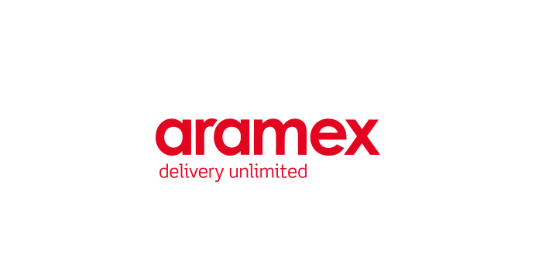














Contact Center Intelligence (CCI) solutions
Add AI/ML to any on-premises/cloud contact center to elevate customer service
Use cases
Self-service virtual agents
Real-time call analytics & agent assist
Post-call analytics
Benefits
Elevate customer experience
Reduce agent frustration, churn
Improve operational efficiency
Derive actionable insights
Customer references
Underlying AI services
Amazon Lex
Amazon Polly
Amazon Transcribe
Amazon Kendra
Amazon Comprehend
Amazon Translate
Guidance
Live Call Analytics with Agent Assist
Post Call Analytics
Notes:
The application of artificial intelligence (AI) and machine learning (ML) to contact centers improves efficiency and effectiveness resulting in better customer experience and reduce cost. These technologies are helping to transform the modern contact center from a cost center into a profit center.
To add AI into your contact center, AWS offers you flexible options.
Amazon Connect is our single, unified omnichannel cloud contact center. It natively offers solutions such as self-service Conversational IVRs and Chatbots. There’s also Contact Lens for Amazon Connect which includes real-time and post-call analytics powered by machine learning.
Then, there are Contact Center Intelligence (CCI) solutions that enable you to augment your existing contact center investments with AWS machine learning (ML) capabilities to gain greater efficiencies and deliver increasingly tailored customer experiences —with no ML expertise required. You can engage an AWS CCI Partner and accelerate deployment with a turnkey solutions or if you need a custom solution, we have a set of consulting partners to help build what you need.
AWS CCI solutions can be applied to these 3 main use cases:
1. Self-service virtual agents includes conversational IVRs and chatbots deflect calls by enable users to quickly find answers and complete transactions on their own, without the assistance of a live agent. These solutions can also identify the intent of a caller and direct them to the proper agent and reduce the number of call transfers. 2. Real-time call analytics and Agent Assist - With CCI, we’re focused on relieving the burden on the agent who’s on the front line communicating with the customer. With real-time call analytics, CCI solutions can process these live conversation and understand the context of the call and with Agent-Assist, reduce agent fatigue from information overload and provide them with real time suggestions for answers pulled from a knowledge base or other data sources. With real-time analytics, customer sentiment can be monitored and supervisors can be alerted to jump in and help their agents with calls that may not be going well. This solution can help to reduce agent call-handling time and reduce agent churn with effective real-time information.
3. Post Call analytics solutions enables you to process 100% of your historic customer interactions which gives you comprehensive coverage of all of your customer conversations. Post-call analytics enables you to gain insights such as emerging trends, customer sentiment, and call drivers, plus it can help to identify customer service and business improvement opportunities. With those insights, you can better understand your customers and derive solutions to help solve their problems faster. You can also setup analytics to assess agent performance and monitor script compliance.
Benefits:
AWS Contact Center Intelligence (CCI) solutions empower you to improve customer experience, boost agent productivity, reduce operational costs and gain conversation insights by adding AI capabilities to the contact center of your choice —without any ML expertise.
Increase customer satisfaction : Reduce call wait times; Quickly route questions to the right agent; Decrease time to resolution; Improve NPS/CSAT scores with faster, more effective customer service.
Boost agent productivity: Reduce call volume; Offload repetitive queries to virtual agents; Enable real-time assistance round the clock; Promote high performing agents & train slow learners; Improve employee retention thus reducing operational costs
Uncover business opportunities: Reduce costs via self-service technologies; High-quality insights on customer satisfaction, emerging trends, and product performance; Monitor call script compliance.
CCI is a horizontal solution that can be applied to all industries. Some of the key industries where we have seen success include: Financial services & Insurance, Retail and eCommerce, Public sector, Healthcare, and Travel & Hospitality.

Slide 24

SOFTWARE & INTERNET | CONTACT CENTER INTELLIGENCE
Gain insights from thousands of calls a day such as user sentiment regarding the company brand, products, or customer interactions
Expand visibility of customer conversation sentiment from 12% to 100% with the help of ML
BUSINESS NEED
Amazon Transcribe is a highly accurate, easy to use speech to text service that contains many features for customization and the call center use case.
With Amazon Transcribe, we have been able to build a sentiment analysis solution that has expanded our customer sentiment visibility from 12% to 100%.
Used Amazon Transcribe, a speech to text service, to convert conversations into usable data with a 92% accuracy rate
Mined the personally identifiable information (PII) redacted, unstructured information from phone calls, and other customer interactions to develop a sentiment analysis system
SOLUTION
Transformed their call analysis workflow from a manual, survey-based process to a fully automated process powered by ML
Detect and trigger proactive care based on negative sentiment and improve visibility on user feedback about products and features, including negative trends related to specific releases
IMPACT
Assaf Elovic
Head of Research & Development
Wix
MORE INFO: BLOG
Notes:
Company: Wix
Industry: Technology
Region: EMEA
Company Description: Cloud-based development platform for building fully personalized, high-quality websites
Use Case: Call analytics
AWS Categories and Services: Amazon Transcribe
Resources:
https://aws.amazon.com/blogs/machine-learning/how-wix-empowers-customer-care-with-ai-capabilities-using-amazon-transcribe/
Quotes:
Amazon Transcribe is a highly accurate, easy to use speech to text service that contains many features for customization and the call center use case. With Amazon Transcribe, we have been able to build a sentiment analysis solution that has expanded our customer sentiment visibility from 12% to 100%. The solution can also detect and trigger proactive care based on negative sentiment. We can also utilize the findings to improve visibility for our product managers on how our users feel about certain products and features, including negative trends related to specific release. In the future, we plan to use Amazon Transcribe to understand not just how users feel, but what topics they’re talking about.”

Slide 25


PUBLIC SECTOR | CONTACT CENTER INTELLIGENCE
The need to stand up one of the largest contact centers in only a few weeks to address questions and concerns regarding a critical healthcare initiative
BUSINESS NEED
CDC selected Maximus as their BPO. Maximus selected SuccessKPI as the end-to-end analytics solution to provide AI, ML, translation, sentiment analysis, across multiple channels
The also used AWS Contact Center Intelligence services such as Amazon Transcribe, Amazon Comprehend, Amazon S3, Amazon SageMaker, Amazon EC2, AWS Lambda, and 20+ other Services
SOLUTION
The CDC has handled hundreds of thousands of inquiries with a comprehensive end-to-end view of agent effectiveness, gained insights in root causes of vaccination hesitancy, and has a full 360° view of the contact center
IMPACT
Notes:
Who: The United States’ health protection agency. The CDC saves lives and protects people from health, safety, and security threats.
Problem: The need to stand up one of the largest contact centers in only a few weeks to address questions and concerns regarding a critical healthcare initiative.
Solution: The CDC selected Maximus as their BPO. Maximus selected SuccessKPI as the end to end analytics solution to provide AI, Machine Learning, translation, sentiment analysis, across multiple channels.Maximus chose a blend of technologies including CRM from Microsoft, Genesys Cloud, Twilio, and SuccessKPI.The full solution required turning up 21k+ agents in under 8 weeks, including testing at scale. The solution included end to end visibility into topics, themes, sentiment, caller journeys, effectiveness of IVR and WFM insights in addition to handling conversations from the callers.
Results: The CDC has handled hundreds of thousands of inquiries with a comprehensive end to end view of agent effectiveness, gained insights in root causes of vaccination hesitancy, and has a full 360 view of the contact center.
Products utilized:AWS Contact Center Intelligence services such as Amazon Transcribe, Amazon Comprehend, Amazon S3, Amazon SageMaker, Amazon EC2, AWS Lambda, and 20+ other Amazon Services.

Slide 26










Conversational AI
Voice and text-based interfaces to enhance end user experience and increase customer satisfaction
Use case categories
Self-service bots
Virtual agents and assistants
Transactional bots
Proactive help based on usage behavior
Benefits
Enable new ways of engagement
Increase customer satisfaction
Reduce operational costs
Streamline business processes
Customer references
Underlying AI services
Amazon Lex
Amazon Polly
Amazon Kendra
Amazon Comprehend
Amazon Translate
Solution
QnABot on AWS
Notes:
Conversational AI interfaces add natural, voice and text conversation capabilities to any application by combining natural language understanding (NLU) and automatic speech recognition (ASR) technologies. Enterprises are utilizing conversational interfaces to create interactive chatbots and virtual assistants that can engage with users 24/7/365 through a variety of devices and meet their individual customer needs.
There are 5 main use cases for AWS Conversational AI solutions:
1. Improved Customer Service by offering a round the clock self-service environment that allows customers to stay connected and ask questions through a variety of virtual, interactive modes.
2. Provide information to customers through chatbots and voice assistants. For example, what are store hours? These tend to be high volume, low complexity tasks.
3. Collect data – Automatically gather information through a conversational interface and save time for your agents. For example, on-boarding a new account or booking an appointment.
4. Fulfill transactions - Enable customers to complete a transaction such as transferring money between bank accounts or paying an outstanding invoice.
5. Prompt user inputs - Prompt the user with help, based on usage behavior through conversational AI. This is a great way to help users complete various forms.
Key Benefits:
With Amazon's Conversational AI (CAI) solutions, enterprises can use AWS AI Services or leverage AWS Partners' expertise to build highly effective chatbot and voice experiences.
New ways of engagement - Conversational interfaces are natural, on-demand 24/7/365, accessible from a variety of devices and increase customer engagement by answering their questions and helping them complete simple tasks.
Increase user satisfaction - Human-like interactions allow customers and employees to self-serve information and boost customer loyalty by removing long hold times waiting for an agent. It simultaneously relieves agent resources that are often tied up answering repetitive questions.
Reduce Operational Costs – Providing 24/7/365 coverage for your customers can be expensive with human agents. CAI allows you to create voice and text virtual agents and bots that can reduce the load on call centers or other support groups in an organization like IT, HR, Finance. Companies can now reduce wait times and lower overall customer support costs.
Omni-channel Accessibility: Lex enables customers to add multiple types of channel to existing customer engagement options. This allows users to converse through their preferred channels, sometimes concurrently. You can have one-click deployment across channels such as Slack, Facebook Messenger, Alexa, web, and can integrate with variety of contact centers platforms like Amazon Connect, Genesys, 8x8, and Avaya.
Streamline business processes: Multi-channel, virtual interactions allow the customer to gather data to increase awareness and productivity. Tied with analytics, this data can be used for gathering feedback and acting on it to improve processes.

Slide 27
TRAVEL | CONVERSATIONAL AI
Ryanair wanted to offer 24/7 access to customer support
BUSINESS NEED
Since the launch in 2018, the Ryanair chatbot has handled almost 3 million conversations across English, Italian, French, Spanish, and German.
We see the Ryanair chatbot as an extension of our customer care team which has played a key role in enhancing our customer’s experience.
A multi-lingual, multi-channel Chatbot platform that leverages Amazon Lex and Amazon SageMaker to optimize responses to customer enquiries. It also uses Amazon Comprehend to provide sentiment analysis, while Amazon Translate is used to localize the input language for processing
SOLUTION
Since the launch in 2018, the Ryanair chatbot has handled almost 3 million conversations
Supports English, Italian, French, Spanish, and German
True extension of the customer service team
IMPACT
Lee Reddin
Head of Service Design
Ryanair
MORE INFO: CASE STUDY | VIDEO
Notes:
Industry: Travel and Hospitality
Region: EMEA
Company Description: Leading European airline
Leading pure-play provider in the administration of government health and human services programs, including Medicaid and Medicare
Wanted customers to have 24/7 access to customer support
Since the launch in 2018, Ryanair chatbot has handled 3M conversations across a variety of languages a year
Since the launch in 2018, the Ryanair chatbot has handled almost 3 million conversations across English, Italian, French, Spanish and German. We see the Ryanair chatbot as an extension of our customer care team which has played a key role in enhancing our customer’s experience.
—Lee Reddin, Head of Service Design at Ryanair
Use Case: Chatbot
Solution: AWS CCI Partner, Cation Consulting uses Parly a multi-lingual, multi-channel Chatbot platform that leverages Amazon Lex and Amazon Sagemaker to optimise responses to customer enquiries, in a perpetually learning environment. It also uses Amazon Comprehend to provide sentiment analysis, while Amazon Translate is used to localize the ingress language for processing.
Business impact:
3 million conversations was over the period of about a year
Resources:
Video Testimonial with Cation Consulting—https://www.youtube.com/watch?v=FAa07VWWy2Y
This is my Architecture (Cation consulting/Ryanair)— https://www.youtube.com/watch?v=dAQhNjwkOX8&feature=youtu.be

Slide 28

PUBLIC SECTOR | CONVERSATIONAL AI
Wanted to develop an interactive robot to communicate with children to provide engaging learning experience for early-childhood children
Needed technology to enable natural-language voice capabilities for the robot
BUSINESS NEED
ROYBI Robot is a very complicated product. But with AWS technology solutions, services, and support, we were able to get to market fast.
Used facial analysis and facial search capabilities from Amazon Rekognition to initiate conversation with users
Leverages Amazon Lex to power the conversational interface for the robot and Amazon Polly to generate a natural-sounding human voice
SOLUTION
Elnaz Sarraf
Founder and Chief Executive Officer
ROYBI
MORE INFO: CASE STUDY | BLOG
Helped develop a friendly, interacting, and educational robot for young students
Sped the robot to market 5 months earlier than expected
IMPACT
Notes:
#FinancialServices #PS #AMER #MLM #CitizenEngagement&Services #Rekognition #Lex #Polly
Problem:
ROYBI Inc. is a startup dedicated to reinventing early-childhood education.
Wanted to develop an interactive robot that could communicate with children with predeveloped learning content to help children build conversational, language and STEM skills
Needed technology to enable natural-language voice capabilities and customized learning.
Solution:
Used Amazon Rekognition to initiate conversations with the user with facial analysis and facial search capabilities
Leverages Amazon Lex to power the conversational interface that allows the ROYBI robot to process and understands what children say
Used Amazon Polly to generate a natural-sounding human voice for the robot
Impact:
Helps develop a friendly, interactive, educational robot for young students
Sped the ROYBI robot to market 5 months earlier than expected
https://aws.amazon.com/solutions/case-studies/roybi-case-study/
https://aws.amazon.com/blogs/publicsector/ai-powered-speech-recognition-creating-interactive-learning-experiences-children-adults/

Slide 29











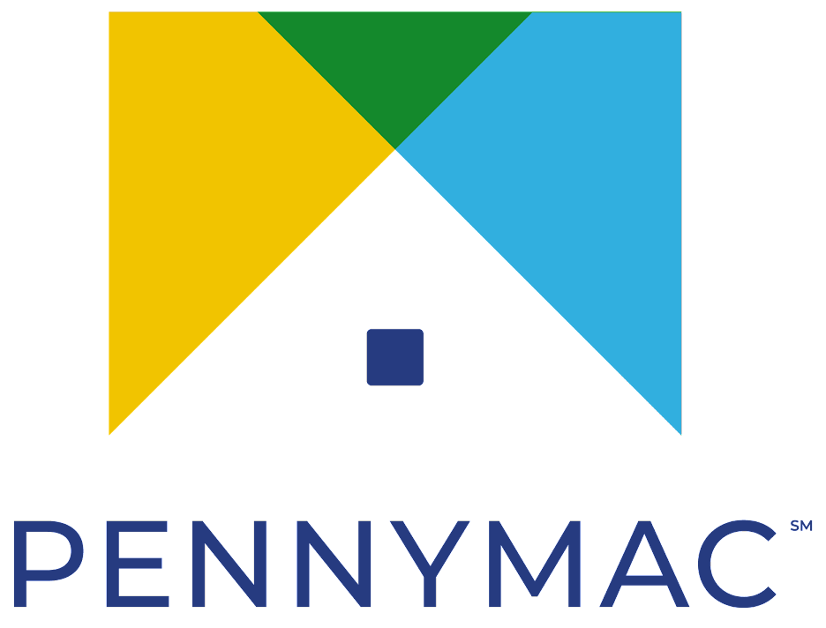

Intelligent document processing
Make faster decisions by automatically extracting and analyzing data from documents
Use case categories
Insurance forms text extraction
Mortgage applications data extraction
Medical forms processing
Financial
Benefits
Higher accuracy of data
Faster data processing
Improve employee productivity
Cost savings
Customer references
AI services
ML Services
Amazon Comprehend
Amazon Textract
Amazon Augmented AI
Amazon SageMaker
Solution
Document understanding solution
Solution
Extract and analyze data from documents
Notes:
Use case categories:
Insurance forms for text extraction (i.e. ACORD forms, health insurance forms)
Mortgage applications, mortgage packets including documents like W-2’s, paystubs, etc.
Medical forms similar to health insurance but could be medical intake forms
Financial documents
Legal documents like contracts
Organizations across industries, including financial services and healthcare, have a large number of documents that require processing, which is time consuming and expensive and often requires human overhead.
Industries:
Financial Services
Healthcare & Life Science
Media & Entertainment
Manufacturing
Benefits:
Using AWS AI services you can get higher accuracy of data using Textract to extract data and Comprehend to understand the data extracted and send this info to downstream applications
AWS AI services are out of the box services so they are easy to implement which means faster data processing and quick set up
By implementing automation, you can improve employee productivity and have employees work on high impact work vs. data entry
Forrester TEI report states customers can save up to 50% in costs by implementing AI into their document pipelines and replacing legacy systems
Other information:
With Amazon Textract, Amazon Comprehend, and Amazon Augmented AI (Amazon A2I), AWS can help you extract data from digital forms and handwritten documents to perform tasks, such as processing loan applications, analyzing customer sentiment, determining patient treatments, or filtering out non-compliant purchases from invoices.
Amazon Textract and Amazon Comprehend use automation and natural language processing to extract data, classify documents, and produce insights that are meaningful to your business. Amazon A2I makes it easy to build and manage human reviews for machine learning applications, when human reviews are critical for data accuracy or compliance.
With AWS, you can extract text and data from virtually any document without manual effort. Process millions of pages in hours, uncover valuable insights, and implement human reviews with intelligent document processing.

Slide 30
HEALTHCARE | MODERNIZING CARE INFRASTRUCTURE
Wanted to automate the insurance claim data extraction process
Took an average of 20 minutes per claim to manually extract information
BUSINESS NEED
We hope technologies like Amazon Textract will help Elevance Heatlh become a digital-first organization.
Used Amazon Textract to digitize and automate claims process
Medical providers submit documents to provider portal and Amazon Textract uses optical character recognition to extract data, indexes, and classify each document
SOLUTION
Reddi Gudla
Staff Vice President
Elevance Heatlh
MORE INFO: CASE STUDY
Extracts and digitizes data to quickly process thousands of claims each day
Automated 80% of claims-processing workflow
Expects to reach 90% automation or higher with AWS
IMPACT
Notes:
#Healthcare #ENT AMER #IDP #Textract
Problem:
Elevance Health is one of the largest health insurance providers in the United States with over 40 million members
Health insurance companies spend millions of dollars to extract sensitive information from claims forms and accompanying attachments to perform their business operations. At Elevance Health it took an average of 20 minutes per claim to manually extract this information. To reduce manual labor, the company wanted to automate the process.
Solution:
Elevance Heatlh used Amazon Textract—a fully managed machine learning service that automatically extracts printed text, handwriting, and other data from scanned documents—to digitize and automate its claims process.
Elevance Heatlh chose Amazon Textract for its image-processing capability, ability to detect tables and forms, and adherence to security and compliance standards.
After a medical provider submits documents to Elevance Heatlh’s provider portal, the documents enter a data store and are sent to a digital-processing function powered by Amazon Textract. Inside this function, Amazon Textract uses optical character recognition to extract data and uses machine learning to automatically index and classify each document. The processed claim is then made available to Elevance Heatlh stakeholders.
Impact:
Extracts and digitizes data to quickly process thousands of claims each day
Automated 80% of its claims-processing workflow
Expects to reach 90% automation or higher on AWS
https://aws.amazon.com/solutions/case-studies/anthem/

Slide 31
FINANCIAL SERVICES | INTELLIGENT DOCUMENT PROCESSING
Broadridge process today is to extract data from SEC filings—specifically proxy voting forms. The data points that they’re extracting are things like the names of the board of directors, their length of tenure, ESG proposals, and others which is manual
BUSINESS NEED
For the document processing and text extraction stage, they leverage Amazon Textract for text extraction from the documents and Amazon Comprehend, for the Natural Language Processing (NLP) which helps pull out names, ESG proposals, tenure, etc.
SOLUTION
By implementing machine learning, Broadridge has been able to reduce the manual efforts of a 160-person team and use them to understand the data hidden within those documents vs. manual entry and analysis
IMPACT
MORE INFO: VIDEO | BLOG
Notes:
Broadridge Advances the Proxy Voting Data Process Using Artificial Intelligence on AWS | AWS for Industries (amazon.com)
Broadridge built its solution using Amazon Comprehend and Amazon Textract. Amazon Comprehend is a natural-language processing service that uses machine learning to uncover information in unstructured data. Amazon Textract, a machine learning service, automatically extracts text, handwriting, and data from scanned documents, forms, and tables.
Reducing Complexity in Document Processing
Broadridge specializes in investor communications, technology-driven solutions, and data analytics. It supports proxy voting services for most of the public companies in North America. The company also handles millions of trades per day involving trillions of dollars, manages shareholder voting in 120 countries, and processes over six billion customer communications annually.
Broadridge’s PPI team uses a manual maker-checker system to process U.S. Securities and Exchange Commission filings. It also uses that system to extract 130 proxy data points from 300,000 meetings held over the past 10 years. The proxy information supplements other existing data and provides insights to broker-dealers, institutional investors, mutual funds, retail investors, regulators, and academics. These insights inform voting decisions and help institutional investors execute smarter governance.
The manual maker-checker system enables a high degree of accuracy, but the process is complex, labor intensive, and difficult to scale. The PPI operations team spends thousands of hours annually on extracting and validating proxy data.
Broadridge initially tried to automate the process using regular expressions and other approaches that would seek out data points and relevant keywords, but the data points were too complex. The company also considered using open-source AI models but worried about maintaining the models and developing the underlying infrastructure.
Designing a Company-Driven Solution
AI was a new technology for Broadridge, and the company turned to AWS to learn how to use AI solutions and design a scalable and extensible AI architecture. In early 2020, Broadridge participated in a 3-day workshop facilitated by multiple AWS teams, including AWS Professional Services.
The company used expertise from the participating AWS teams to define the project’s scope and align on how to measure and validate accuracy for an extensible, event-driven serverless architecture. The first phase took approximately 35 data points and aimed for 70 percent accuracy in processing. The second phase focused on putting the models into production.
The initiative relied on executive and management support, which included leadership from Martin Koopman, bank broker-dealer and president of Investor Communication Solutions at Broadridge. Koopman held a Broadridge AI summit and organized AWS DeepRacer events, which provide hands-on machine learning experience through a cloud-based, 3D racing simulator and fully autonomous 1/18-scale race car.
The AWS consultation process helped Broadridge understand its skill gap and build a new data science and architecture team to move the project forward. During each phase of the project, Broadridge used support from AWS Professional Services to train the new team and troubleshoot issues. Broadridge conducted an AWS Well-Architected Review to identify focus areas prior to user acceptance testing. The review applies the principles of the AWS Well-Architected Framework, which was developed to help cloud architects build secure, high-performing, resilient, and efficient infrastructure for their applications.
Broadridge developed a fully managed serverless architecture that uses AWS Lambda for pre- and postprocessing and AWS Step Functions to orchestrate the pipelines. AWS Lambda is a serverless compute service that lets customers run code without provisioning or managing servers. AWS Step Functions is a visual workflow builder used to orchestrate AWS services, automate processes, and build serverless applications. The solution’s key AI building blocks—Amazon Textract and Amazon Comprehend—assemble the results.
Building an AI Solution That Saves Time and Reduces Costs
Using the event-driven serverless architecture on AWS, Broadridge automated data extraction and achieved the required 70 percent accuracy threshold. In early 2021, the company launched the automated process in production. While Broadridge continues to manually audit the data, it expects the automated process to save thousands of hours annually. This will help Broadridge save costs and achieve scale.
With faster document processing, Broadridge expects to deliver data more quickly to its customers and reduce its manual process delivery time of 1–7 days. As Broadridge continues to automate data processing, it hopes to further increase scalability and expand the number of data points available to customers, delivering deeper insights.
Automating the maker segment of the maker-checker system also helps Broadridge enhance voter experience by personalizing voting insights according to issues that matter to clients. Regulators, academics, and nonprofit organizations use the PPI tool for free.

Slide 32
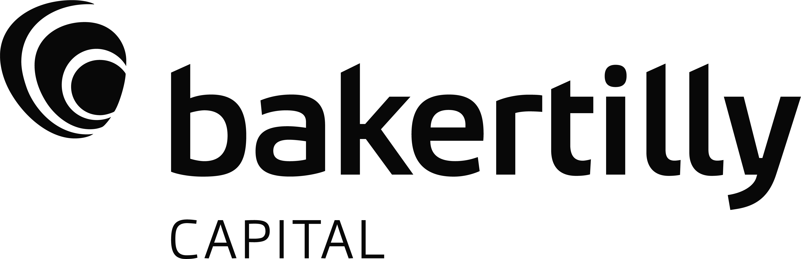



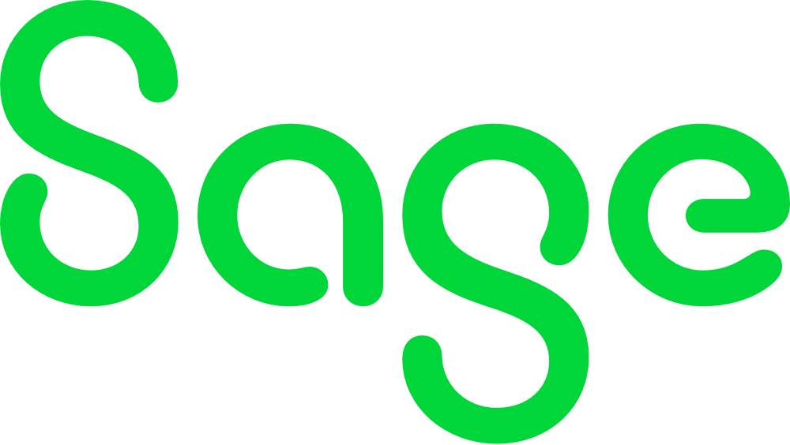


Intelligent search
Get the most out of your data with Intelligent Search
Use case categories
Improve customer interactions
Accelerate research and development
Minimize regulatory & compliance risks
Equip employees with the data they need
Benefits
Find answers faster across unstructured content
Boost workforce productivity
Enhance customer experiences
Centralize access to knowledge
Customer references
Underlying AI services
Amazon Kendra
Notes:
Better search is a fundamental need for virtually every industry….whether it’s to accelerate global research efforts or enabling customers to self serve more effectively, making sense of data and getting to relevant information faster is crucial.
Amazon Kendra offers a ready-to-use intelligent search powered by AI; no prior ML knowledge required. It helps users get answers faster from siloed and unstructured information sources across an organization. Using Amazon Kendra, you can stop searching through troves of unstructured data and discover the right answers to your questions, when you need them.
Amazon Kendra is a fully managed service with built-in connectors to many data repositories along with application development tools to integrate search into applications quickly.
Intelligent Search helps boost business productivity and customer satisfaction by quickly delivering accurate and useful information to employees, customers, and partners. Kendra can return snippets from documents and direct answers delivering higher accuracy answers and eliminating the need to go into documents.
This use case can be found in the following industries: Software & Internet, Healthcare & Life Sciences, Financial Services, Manufacturing, and Telecommunications among others

Slide 33
MANUFACTURING | INTELLIGENT SEARCH
When their scientists lead a new research, they need access to information from prior relevant research
Finding information is often exhausting and time-consuming
BUSINESS NEED
When our material scientists lead new research, they need access to information from prior relevant research—information that’s buried in the many patents we hold in our huge knowledge base. Kendra lets our scientists find the information they need by handling natural language queries quickly and accurately.
Uses Amazon Kendra to help scientists find the information they need by handling natural language queries quickly and accurately
SOLUTION
Allows engineers and researchers to find information much faster
With this new “superpower” scientists expect to be able to innovate faster, collaborate more effectively, and accelerate the ongoing stream of unique products for their customers
IMPACT
David Frazee
Technical Director, Corporate Research Systems Lab
3M
Notes:
“At 3M, a Minnesota-based multinational corporation that produces adhesives, medical products, and much in between, science is at the heart of everything we do. For us, R&D is the heartbeat of 3M; we invest deeply into the science that makes 3M strong. That investment is the key that enables us to introduce over 1,200 new products every year. When our material scientists lead new research, they need access to information from prior relevant research—information that’s buried in the many patents we hold in our huge knowledge base. Finding the right information is often exhausting (but not exhaustive) and time-consuming. To address this problem, we decided to use Amazon Kendra, a powerful new AWS offering. Kendra lets our scientists find the information they need by handling natural language queries quickly and accurately. With Kendra, we expect our engineers and researchers will find information much faster than they did before we used Amazon Kendra. Our scientists are enthusiastic about this new superpower and we expect them to be able to innovate faster, collaborate more effectively, and accelerate the ongoing stream of unique products for our customers.”
David Frazee, Technical Director, 3M Corporate Research Systems Lab

Slide 34

HEALTHCARE | INTELLIGENT SEARCH
In a sea of ever-evolving, complex healthcare information, documents and records change daily. It is difficult to provide contact center agents with access to the latest and most up to date information
BUSINESS NEED
We chose Amazon Kendra to build a secure and scalable agent assist solution. This helped call center agents and the customers they serve quickly uncover the information they need.
Since implementing Contact Center Intelligence (CCI) and Amazon Kendra, early results show an average reduction in call times of about 9–15 seconds, which saves over 4k hours on over 2.2 million calls per calendar year.
Implemented Amazon Kendra and Contact Center Intelligence (CCI) to help call center agents, and the customers they serve quickly uncover the information they need
SOLUTION
AWS helps to reduce agent training by 3–5 days and increases agent call handling volume. Magellan Rx was able to lower the average call time by 9–15 seconds, which saves over 4K hours on over 2.2 million calls per calendar year
IMPACT
Brian Licthle
Senior Director of Software Engineering
Magellan Rx

Slide 35











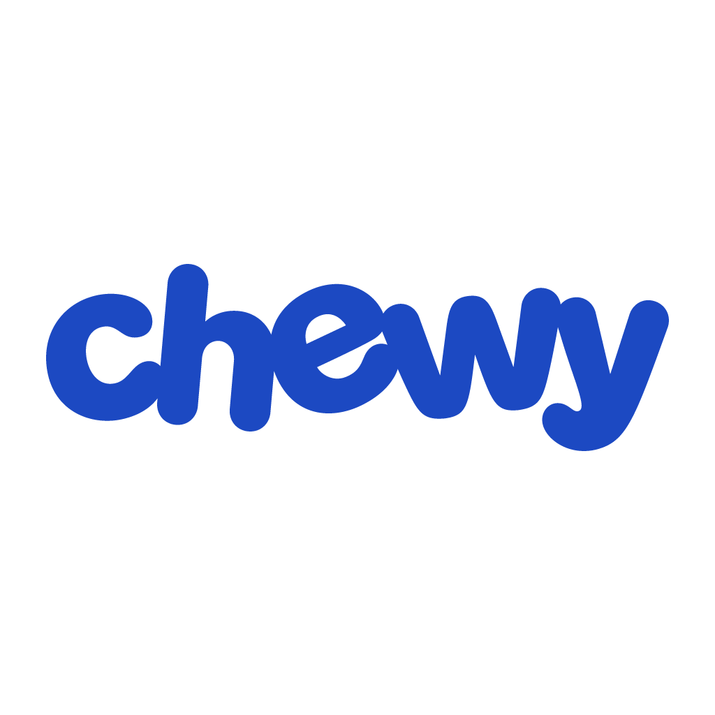







Personalization
Generate personalized recommendations to increase customer engagement
Use case categories
Deliver unique homepage experiences
Help customers discover products faster
Target customers more accurately
Highlight new products, content, and promotion offerings
Benefits
Implement a personalization engine in days, not months—no ML expertise required
Adapt recommendations in real time
Increase engagement and revenue through relevancy
Customer references
AI services
ML Services
Amazon Personalize
Amazon SageMaker
Solution
Maintaining Personalized Experiences with Machine Learning
Solution
Personalized recommendations
Notes:
Seller notes: With pre-built recommenders for popular use cases including specific product or content recommendations, individualized search results, and customized marketing communications, Amazon Personalize automates many of the complicated steps required to build, train, and deploy a ML model, making it easy to develop applications with the same machine learning (ML) technology used by Amazon.com – no ML expertise required. Personalization often involves multiple buyer and influencer personas because the use case crosses both IT and Line of Business (LOB) operations. If the strategic decision to add personalization or an automated recommendation system has been made and there is less need to engage deeply with the C-Level, then we recommend that you connect with: 1) marketers; 2) architects; 3) application owners and developers; 4) UX decision makers; or 5) data scientists, to accelerate the customer into a POC and tech validation phase. Use cases:
Create unique user experience: Increase engagement and conversion by providing dynamic customer experiences and the optimal product or content recommendations using a blend of real-time user activity data and user profile information.
Help customers discover products faster: Solve common problems like “popularity bias” (merely showing a customer the most popular products or content) and “cold start” (where no user, item, or content history exists), which dilutes the customer experience and ability to discover new items or content in an organization’s catalog.
Enhance marketing communication: Intelligent user segmentation allows you to run more effective prospecting campaigns through your marketing channels. With our two new recipes, you can automatically segment your users based on their interest in different product categories, brands, and more .
Refine product recommendations: With pre-built recommenders, you can easily deliver high-performing personalized user experiences by selecting the right recipes, such as: “Frequently Bought Together,” “Because You Bought X,” “Top Picks for You,” and more. Map your data to a recommender; Amazon Personalize chooses the optimal settings for your use case and automates the work of creating and maintaining personalized recommendations.

Slide 36

FINANCIAL SERVICES | PERSONALIZATION
Paytm wanted to increase the sales and click-through rates of Paytm Mall by implementing personalized recommendations for 10M+ daily active users on the homepage of its site
BUSINESS NEED
Using Amazon Personalize has helped us innovate and rethink our whole approach to improving sales conversions.
Paytm created a personalization model with Amazon Personalize that generates recommendations for each customer on the Paytm Mall homepage using outputs from Amazon EMR, which processes Paytm users’ browsing and shopping history
SOLUTION
Ankur Gogate
Technical Lead
Paytm
MORE INFO: CASE STUDY
Paytm has seen a 5.5–6% conversion rate from the new personalized homepage, which is 3 times more than their previous item-to-item recommendations
IMPACT
Notes:
Paytm is a great example of how you can co-sell Personalize with other Amazon services, like EMR.
Problem
Paytm, an India-based digital payments, ecommerce, and financial services provider, wanted to increase the sales and click-through rates of its ecommerce service, Paytm Mall, by implementing personalized recommendations on the homepage of its site. To create this recommendation model, Paytm needed a robust machine learning (ML) solution to analyze and propose recommendations to over 10 million daily active users who shop for retail goods on Paytm Mall.
At the time, Paytm was providing recommendations to customers on an item-to-item level; when a user was on the page of an item, this widget would suggest other products that were often purchased together. However, the item-to-item recommendation model did not take the individual user’s needs and preferences into consideration. It was also buried in the user journey, and a customer would have to search for and click on an item to see these suggestions.
Solution:
Amazon EMR creates the data outputs that can then be put into Amazon Personalize to run through the recommendations model. The personalized results from Amazon Personalize are pushed to the homepage, where users can see recommendations for products that they’re likely to be looking for, such as clothing items similar to ones that they’ve searched for previously.
Impact:
Since adding the personalized recommendations model, Paytm has seen a 5.5–6 percent conversion rate from the Paytm Mall homepage, which is three times more than the widgets Paytm had been using previously for item-to-item recommendations. Implementing personalization has also helped Paytm better measure activity on it’s homepage, which they previously didn’t have much insight into.

Slide 37
RETAIL/CONSUMER PACKAGED GOODS (CPG) | PERSONALIZATION
Pomelo Fashion had been displaying items in the same web format since its founding. The setup had grown stale, and the algorithm for displaying products relied on old data streams with limited inputs and spotty accuracy
BUSINESS NEED
When you think of e-commerce, you think of AWS.
New services are always coming out on AWS, and support is very good.
Pomelo Fashion used Amazon Personalize to build a recommendation engine to personalize the shopping experience to each customer. It now reflects user preferences on product pages in minutes, driving sales
SOLUTION
Shane Leese
Business Intelligence Director
Pomelo Fashion
MORE INFO: CASE STUDY | VIDEO
Boosted click-through rate from category to product pages by up to 18%
Increased gross revenue from category pages by up to 15%
Increased return on investment by 400% within 1 month
IMPACT

Slide 38












Predictive maintenance
Improve uptime and reduce industrial costs
Benefits
Detect abnormal conditions in industrial equipment, and prevent problems before they occur
Improve uptime of industrial equipment
Reduce costs of unplanned downtime
Allow reliability and maintenance engineers to make more informed decisions
No ML experience required
Partners
Customer references
Underlying AI services
Amazon Monitron
Amazon Lookout for Equipment
Solution
Predictive Maintenance Using Machine Learning

Slide 39
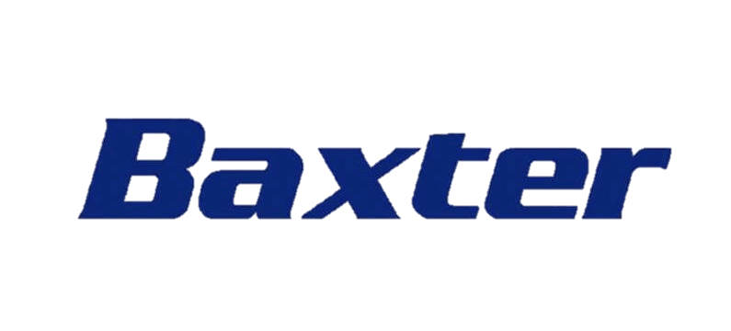
MANUFACTURING | PREDICTIVE MAINTENANCE
Baxter’s network of 70 manufacturing sites worldwide operates 24/7 in a highly complex, dynamic, and regulated environment. Baxter needed an equipment-monitoring solution that could build resiliency in its operations and reduce unplanned equipment downtime so that the company could deliver lifesaving products to customers and patients on time.
BUSINESS NEED
Amazon Monitron has given us the actionable data needed to maintain the thousands of manufacturing assets in our facilities, allowing us to predict and preempt unplanned equipment downtime.
Baxter uses Amazon Monitron to detect abnormal conditions in its manufacturing equipment. The company’s technicians can review issues immediately and schedule maintenance rather than responding to emergency repairs.
SOLUTION
Prevented 500 machine hours of unplanned downtime in one facility
Reduced manual inspection time for technicians
Improved operational efficiency and quality by automating inspection tasks
A. K. Karan
Global Senior Director of Digital Transformation, Baxter International
MORE INFO: CASE STUDY | VIDEO
IMPACT
Notes:
#Manufacturing #ENT #AMER #MLM #PredictiveMaintenance #SageMaker
Global medical technology company Baxter International Inc. (Baxter) prevented over 500 machine hours of unplanned downtime using 2,500 Amazon Monitron sensors in its largest facility in the United States. Baxter’s mission is to save and sustain patient lives, delivering products to treat chronic and acute medical conditions. To reduce unplanned equipment downtime in its facilities, which run around the clock, Baxter needed an equipment-monitoring solution that was simple to deploy, equipment agnostic, cost efficient, and scalable. The company’s shift from a reactive to a predictive maintenance strategy resulted in improved business processes using Amazon Monitron.
RESOURCES
Case study | https://aws.amazon.com/solutions/case-studies/baxter-monitron-case-study/
Video | https://www.youtube.com/watch?v=xR_Mcecn5kk
re:Invent 2022 leadership session | https://youtu.be/Jf1ca54dofI?t=3050
re:Invent 2022 predictive maintenance breakout session | https://youtu.be/hvIjkOEe9C4?t=955

Slide 40
MANUFACTURING | IMPROVING ASSET PERFORMANCE
Detecting potential failures of industrial equipment, such as compressors, is critically important as this reduces downtime and maintenance costs. Koch Ag & Energy Solutions (KAES) needed a way to detect these issues before they occurred
BUSINESS NEED
We needed a solution to detect acoustic anomalies and potential failures of critical manufacturing machinery. Within a few weeks, the experts at the ML Solutions Lab worked with our internal team to develop an alternative, state-of-the-art, deep neural net embedding sound featurization technique and a prototype for acoustic anomaly detection. We were very pleased with the insight that the ML Solutions Lab team provided us regarding our data and educating us on the possibilities of using Amazon Lookout for Equipment to build and deploy anomaly detection models for new assets.
KAES used Amazon Monitron and Amazon Lookout for Equipment, machine learning services that detect abnormal equipment behavior and enable predictive maintenance, to monitor industrial equipment including compressors
SOLUTION
Amazon Monitron proactively detected a possible failure in a fan at a nitrogen producing facility by alerting on increased vibrations. This led KAES to swap fans and clean the inlet filter avoiding the risk of complete loss of air. Because of this, KAES avoided running lengthy maintenance workflows which are costly and cumbersome
IMPACT
Dave Kroening
IT Leader
Koch AG & Energy Solutions
MORE INFO: VIDEO | PRESENTATION | BLOG

Slide 41






Content moderation
Create safe online environments, protect your brand, and minimize moderation costs
Use case category
Gaming
Social media
E-commerce
Advertising
Benefits
Improve safety for users and brands
Streamline content moderation operations
Increase reliability and lower costs
Customer references
Underlying AI services
Amazon Augmented AI
Amazon Rekognition
Amazon Transcribe
Amazon Comprehend
Amazon Translate
Guidance
AWS Solution Guidance
Notes:
Machine Learning Content Moderation Use Case Narrative (1/Positioning, 2/Benefits, 3/AWS viability)
1/POSITIONING (problem, solution, AWS offering, link to benefits) Create safe online environments, protect your brand, and reduce moderation costs.
The daily volume of third party and user generated content (UGC) across industries is increasing exponentially, as well as the requirements and the cost to keep content and online communities safe and compliant. Customers are learning that human-based moderation processes cannot scale to meet safety, regulatory, and operational needs in the UGC era. From startups to well-established social media, gaming, e-commerce, online advertising, and photo sharing organizations, they all have to trade off technical, financial, and human resources to ensure that customers are not exposed to offensive material while keeping operational costs down. Customers in the broadcasting and media industries find challenging to efficiently add ratings to content to comply with guidelines across markets, audiences, media types, and formats. Other customers in highly regulated industries, such as financial and healthcare services find challenging the protection of personally identifiable and health information (PII and PHI) across internal and external environments. Some companies employ large teams of human moderators, while others can only react when users have already seen the disturbing media or sensitive information. The consequences are a poor user experience, high moderation costs, increased brand risk, and liability.
Automated content moderation that is powered by artificial intelligence (AI) and machine learning (ML) can help your organization moderate the deluge of UGC and reclaim up to 95% of the time your teams spend moderating content manually, to effectively protect users from harmful exposure, while reducing content moderation costs, and safeguarding your organization and your customers from risk, liability, and brand damage.
AWS offers AI services to implement solutions without requiring ML expertise, or that can be tailored to your specific content and business needs. Streamline image, video, text, and audio moderation workflows with ready-to-use content moderation APIs to enable multi-modal capabilities. Meet safety and compliance guidelines with granular moderation rules that are specific to your own standards and practices (S&P). Automate tasks completely or significantly reduce human moderation workloads to implement a review stage of ML predictions. Extend the value of your investment and increase your speed to market with deep learning (DL) and natural language processing (NPL) technologies. With AWS services and content moderation solutions, you get coverage for all your moderation needs as your business scales, improving content safety, automating, and streamlining moderation workflows, while increasing reliability and lowering operational costs.
2/BENEFITS (description, services, customer reference) Improve safety for users and brands
Proactively protect users from inappropriate content and brands from unwanted associations at scale by reviewing all UGC that goes to market. Review images and videos against a wide variety of pre-defined categories, or from your own list of prohibited terms with Amazon Rekognition. Extend your moderation capabilities to speech and other audio files with Amazon Transcribe. Complement the moderation process with contextual insights and sentiment, or simply detect, redact and mask PII and PHI with Amazon Comprehend. SmugMug flags unwanted content and highlights its best photos across tens of billions of images, inspiring its users and the Flickr community to safely store, discover, share, and sell media online.
Streamline content moderation operations Eliminate the need to build new tools, manage content infrastructure, or large moderation teams, with pre-trained yet customizable AI services and models. Automatically flag unsafe content first to fully automate or to reduce the human moderation workflow. Proactively detect inappropriate, unwanted, or offensive content containing nudity, suggestiveness, violence, and other such categories with Amazon Rekognition. Automatically convert speech in videos and audio to text and run profanity and hate speech checks with Amazon Transcribe. Extend content analysis to uncover connections and insights that inform your moderation workflows with the NLP capabilities in Amazon Comprehend. Strategically bring human oversight to ensure accuracy and to retrain models with Amazon Augmented AI. Mobisocial ensures that its gaming community socialize and share content in a safe environment, while enabling its technical talent to focus on their core business, by flagging non-compliant content through a 95% automated moderation workflow.
Increase reliability and reduce moderation costs Create reliable, scalable, and repeatable cloud-based content moderation workflows without upfront commitments or expensive licenses. Pay by the number of images or length of videos that you want to process, and scale as needed. Dream11 automates the analysis of thousands of user generated videos and images daily, scaling the business as needed to protect 100 million members in its fast-growing fantasy sports community.
3/AWS VIABILITY (why AWS) AWS offers more computer vision services than any other cloud provider, to help you implement fast and secure content moderation solutions, out of the box or customized to meet your business needs. AWS is the world’s most broadly adopted cloud platform, offering over 200 fully featured services from data centers globally. Many AWS Computer Vision and content moderation customers—including the fastest-growing startups, large enterprises, and leading government agencies—are using AWS to lower costs, become more agile, and innovate faster.

Slide 42
SOFTWARE & INTERNET | CONTENT MODERATION
Flipboard processes approximately 90M images per day
To maintain a safe and inclusive environment and to confirm that all images comply with platform guidelines at scale, it is crucial to implement a content moderation workflow
BUSINESS NEED
Amazon Rekognition is a highly accurate, easily deployed, and performant content moderation platform that provides a robust moderation taxonomy.
Amazon Rekognition gives Flipboard a robust moderation taxonomy and lower false positives inferences that helps intercept unwanted content more efficiently
SOLUTION
Anuj Ahooja
Sr. Engineering Manager
Flipboard
MORE INFO: PRESENTATION
Lower false positive rates imply lower volumes of flagged images to be reviewed further, leading to a better experience for human moderators and more cost savings
Since putting Amazon Rekognition into their workflows, they have caught approximately 63K images that violate their standards per day
IMPACT
Notes:
Amazon Rekognition improves accuracy of content moderation for images

Slide 43
SOCIAL MEDIA | CONTENT MODERATION
Guarantee an enjoyable and a safe experience for customers searching for their soulmates
BUSINESS NEED
With Amazon Transcribe and its custom vocabulary feature, banned terminology can be identified and redacted.
Looking forward, our team is excited to grow the Voice Pococha community with the support of services like Amazon Transcribe and the Amazon Web Services team.
Use Amazon Transcribe and its custom vocabulary feature to identify and redact words that are typically slang and not recognized by standard speech-to-text services
SOLUTION
Higher detection accuracy for words that were challenging to spot as harmful in the past, and faster moderation response times that continuously keeps the Pococha community safe and engaged
Takuto Noguchi
Product Owner, Live Streaming
DeNA
IMPACT

Slide 44



Identity verification
Enable secure and compliant digital experiences
Use case category
Customer onboarding & verification
Online proctoring
Gig economy verification
Event & airport check-ins
Use challenges
Benefits
Reduce onboarding friction
Reduce fraud
Lower costs and overheads
Customer references
Underlying AI services
Amazon Rekognition
Amazon Textract
Guidance
AWS Solution Guidance

Slide 45













Forecasting
Forecast inventory, product demand, financial metrics, and workforce staffing
Use case category
Retail inventory forecasting
Supply chain demand planning
Revenue and financial metrics forecasting
Workforce planning and staffing
Benefits
Grow retail sales through fewer stockouts
Lower costs by reducing wasted inventory
Increase profitability through improved product allocation
Optimize workforce productivity & staffing
Customer references
AI Services
ML Services
Amazon Forecast
Amazon SageMaker
SageMaker Canvas
Guidance
Improving Forecast Accuracy with ML
Solution
Demand Forecasting
Notes:
Companies today use everything from simple spreadsheets to complex financial planning software to accurately forecast future business outcomes, such as product demand, resource needs, or financial performance. These tools build forecasts based on historical data and trends. However, the tools struggle to take irregular past trends into account, especially data series that change over time (such as price, web traffic, or number of employees).
Amazon Forecast is a fully managed service that uses machine learning to deliver highly accurate forecasts. Amazon.com uses the same technology to forecast key metrics.
Accurately predict demand forecasting and streamline supply-demand decision-making by using machine learning to combine historical time-series data with additional variables, such as product features, pricing, and holidays.

Slide 46



AMAZON
END-TO-END ML JOURNEY
SageMaker
Build, train, and deploy ML models for any use case with fully managed infrastructure, tools, and workflows
BUILD
TRAIN
DEPLOY
Notes:
Now let’s take a closer look at Amazon SageMaker.
As I mentioned earlier, SageMaker enables customers to easily build, train, and deploy ML models for any use case – and with tools for every step of ML development.

Slide 47
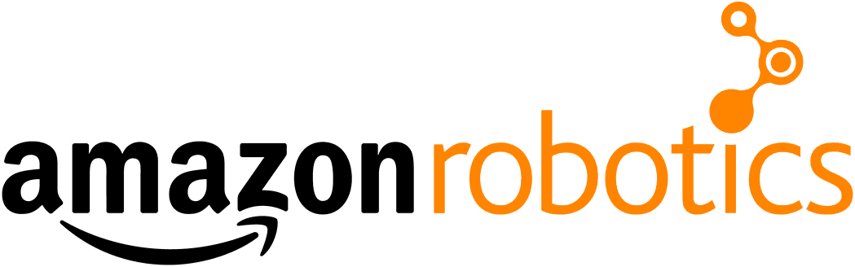
RETAIL | ML MODERNIZATION
Used machine learning to streamline the flow of inventory in fulfillment centers
Ran into challenges scaling and managing infrastructure required to host ML models
BUSINESS NEED
Amazon SageMaker doesn’t just manage the hosts we use for inferencing.
It also automatically adds or removes hosts as needed to support the workload.
Modernized ML model development process using Amazon SageMaker
SageMaker Experiments to track, compare, and evaluate model versions during training
SageMaker to manage and scale hosts elastically
Migrated inference workloads to AWS Inferentia based Inf1 instances
SOLUTION
Eli Gallaudet
Senior Software Manager
Amazon Robotics
MORE INFO: CASE STUDY
Saved ~70% on inferencing costs compared to self-managed solution
Improved model performance by 40%
Scales to over 200 million inferences per day
IMPACT
Notes:
#Retail #INT #GLBL #MLModernization #SageMaker
Problem:
1/Amazon Robotics set out to use machine learning to streamline the flow of inventory in its fulfillment centers. There are three main physical components to the company’s system: mobile shelving units, robots, and employee workstations. The robots deliver mobile shelving units to stations, and employees either put inventory in (stowing) or take it out (picking). The existing stow-and-pick workflows were sometimes creating bottleneck for downstream processing. In 2017, Amazon kicked off an initiative to simplify some of those workflows.
2/Looking to reduce time-consuming bin scanning, Amazon Robotics built the Intent Detection System, a deep-learning-based computer vision system trained on millions of video examples of stowing actions. The company trained the system to automatically identify where associates place inventory items. Although Amazon Robotics could tap into ample compute resources on AWS, it ran into challenges of scaling and managing the infrastructure required to host the ML models.
Solution:
3/Amazon Robotics was the first company to deploy to Amazon SageMaker on a large scale and remains one of the largest deployments as of January 2021. At first the team primarily used Amazon SageMaker to host models and reduced inferencing costs.
4/They then started adopting other SageMaker features, such as SageMaker Experiments—a capability that enabled the team to organize, track, compare, and evaluate ML experiments and model versions.
5/Amazon Robotics also uses Amazon SageMaker automatic scaling, which automatically adds or removes hosts as needed to support the workload.
6/Since SageMaker provides secure, resizable compute capacity in the cloud for ML and enables users to quickly migrate host types as newer host types become available. The Amazon Robotics team took advantage of this, initially choosing Amazon EC2 P2 Instances but eventually migrating to the AWS Inferentia based Amazon EC2 Inf1 Instances. AWS custom designed the AWS Inferentia chip to provide high performance, low latency, and lowest cost inference in the cloud. Each AWS Inferentia chip supports up to 128 TOPS (trillions of operations per second) of performance. Amazon EC2 Inf1 instances based on AWS Inferentia chips deliver up to 30% higher throughput and up to 45% lower cost per inference than Amazon EC2 G4 instances, which were already the lowest cost instance for machine learning inference available in the cloud.
Impact:
7/With SageMaker, Amazon Robotics doesn’t need to procure or manage its own fleet of over 500 GPUs. This along with the migration to Inf1 instances has saved the Amazon close to 70 percent on its inferencing costs compared to the previous self-managed solution.
8/The team was also able to improve model performance by 40% with its migration to SageMaker…
9/…and are able to scale to a throughput of 200M+ inferences per day.
Full case study: https://aws.amazon.com/solutions/case-studies/amazon-robotics-case-study/

Slide 48
LIFE SCIENCES | RESEARCH & DISCOVERY
Wanted to speed up all stages of research and development, particularly the review of tissue samples
Labeling data was time-consuming and tedious
BUSINESS NEED
“
It’s the start of a broad change in our business—using all of this imaging and molecular data along with AI to develop a holistic approach, one that lets our scientists interact and interpret the data in ways that have never been possible.
Partnered with the Amazon ML Solutions Lab to integrate Amazon SageMaker Ground Truth to automate tedious portions of work
Helps annotate, collect and classify ML model training data quickly
SOLUTION
Richard Goodwin
Director for Molecular Imaging
AstraZeneca
MORE INFO: ARTICLE | CASE STUDY
Reduces time humans spend cataloging samples by at least 50%
Accelerates the drug research process and the introduction of medicines to the market
Increases the pace of research by freeing up scientists
IMPACT
Notes:
#LifeSciences #ENT #GLBL #MLM #Research&Discovery #ClinicalTrials/Development #SageMaker
Problem:
AstraZeneca is a global biopharmaceutical business focused on innovation and the delivery of life-changing medicines that contribute value to patients and society.
To remain a leader in the competitive pharmaceutical industry, AstraZeneca wanted to speed up all stages of research and development, particularly the review of tissue samples.
The company is using machine learning models to help them accomplish this, but labeling the data is a time-consuming step. It can take many thousands of tissue sample images to train an accurate model.
Solution:
Partnered with the Amazon Machine Learning Solutions Lab (MLSL) to build a data labeling and annotation service, using Amazon SageMaker Ground Truth, to automate the most tedious portions of this work
Helps annotate, collect and classify training data quickly
Impact:
Reduces time humans spend cataloging samples by at least 50%, freeing up scientists’ time so they can do more research
Accelerates the drug research process and the introduction of medicines to the market
Increases the pace of research
Allowed the company to develop techniques to accurately identify the key structures affected by diabetic injury with a 95% success rate and minimal false negatives
“It’s the start of a broad change in our business—using all of this imaging and molecular data along with AI to develop a holistic approach, one that lets our scientists interact and interpret the data in ways that have never been possible.”
— Richard Goodwin, Director for Molecular Imaging, AstraZeneca
https://www.wired.com/brandlab/2019/07/machine-learning-is-transforming-drug-development/

Slide 49

AUTOMOTIVE | ML MODERNIZATION
Complex object detection models for autonomous driving
Needed to reduce training time to get models to market faster
BUSINESS NEED
We generate an incredible amount of data and use a substantial amount of computational infrastructure.
In simulation, we leverage S3 to store simulated logs, we use RDS databases to track the performance and metrics, and then we use massive of amounts of EC2 Spot Instances powering EKS for our largest distributed workloads. It’s actually kind of incredible.
Standardized on Amazon SageMaker as the ML platform of choice
Model training primarily done on SageMaker
Integrated end-to-end workflow using SageMaker to take models from research to production deployment
SOLUTION
Reduced model development cycle time from weeks to less than a day, accelerating the pace of innovation
Increased data scientist productivity by 10x
Chris Urmson
Co-founder and CEO
Aurora
MORE INFO: CASE STUDY | PRESS RELEASE
IMPACT

Slide 50

ENERGY | ML MODERNIZATION
BP p.l.c. (bp) wanted to accelerate the process of delivering data science products at scale through a DevOps framework specifically designed for model management and deployment
BUSINESS NEED
The Model DevOps Framework, powered by AWS, creates a standardized approach to provide control, management, monitoring, and auditability of data models while enforcing code quality.
Using Amazon SageMaker and AWS Professional Services, bp provided its data scientists with the ability to self-provision environments to experiment and roll out products more quickly and without requiring cloud engineering resources
SOLUTION
Chris Coley
In-house Data Scientist & Product Owner for the Model DevOps Framework, Innovation & Engineering
BP P.L.C.
MORE INFO: CASE STUDY
Implemented the Model DevOps Framework in 9 months
Reduces reliance on cloud engineering resources
Helps monitor and maintain data models and code
IMPACT
Notes:
Challenge BP p.l.c. (bp) wanted to accelerate the process of delivering data science products at scale through a devops framework specifically designed for model management and deployment that bp data scientists and engineers to focus on high-value activities, from experimentation to rapid production deployment, by reducing time spent on non–data science activities, such as provisioning and architecture design.
Solution
Using Amazon SageMaker and AWS Professional Services, bp provided its data scientists with the ability to self-provision environments to experiment and roll out products more quickly and without requiring cloud engineering resources. The framework runs on a cost-efficient serverless architecture, so bp can manage its cloud resource usage and use only the compute that it needs for its training jobs.
Benefits
Implemented the Model DevOps Framework in 9 months
Empowers data scientists and engineers to focus on high-value activities
Accelerates data science project delivery at scale Facilitates code quality for developing and running models in production
Reduces reliance on cloud engineering resources
Standardized architecture and streamlined the digital security review process
Helps monitor and maintain data models and code
Expects cost savings of 5%–25% across solution design and provisioning

Slide 51
AUTOMOTIVE | ML MODERNIZATION
Develops computer vision models for autonomous driving
Needed to reduce training times to accelerate model development
BUSINESS NEED
We use computer vision models to do scene segmentation, which is important for scene understanding. It used to take 57 minutes to train the model for 1 epoch, which slowed us down. Using Amazon SageMaker’s data parallelism library and with the help of the Amazon ML Solutions Lab, we were able to train in 6 minutes with optimized training code on 5ml.p3.16xlarge instances. With the 10x reduction in training time, we can spend more time preparing data during the development cycle.
Amazon SageMaker data parallelism library to speed up training jobs
SageMaker Debugger to monitor, trace, and analyze performance issues
Performance optimization with Amazon ML Solutions Lab
SOLUTION
10x faster model training using SageMaker data parallelism library and Amazon ML Solutions Lab’s code optimization
Hyundai Motor Company can now focus on data preparation and accelerate the development cycle
IMPACT
Jinwook Choi
Senior Research Engineer
Hyundai Motor Company
MORE INFO: BLOG
Notes:
#Automotive #ENT #AMER #MLM #AutonomousVehicles #MLModernization #SageMaker
Problem:
Develops computer vision models for autonomous driving
Needed to reduce training times to accelerate model development
Solution:
Amazon SageMaker data parallelism library to speed up training jobs
SageMaker Debugger to monitor, trace, and analyze performance issues
Performance optimization with Amazon ML Solutions Lab
Impact
10x faster model training using SageMaker data parallelism library and Amazon ML Solutions Lab’s code optimization
Hyundai Motor Company can now focus on data preparation and accelerate the development cycle
”We use computer vision models to do scene segmentation, which is important for scene understanding. It used to take 57 minutes to train the model for 1 epoch, which slowed us down. Using Amazon SageMaker’s data parallelism library and with the help of the Amazon ML Solutions Lab, we were able to train in 6 minutes with optimized training code on 5ml.p3.16xlarge instances. With the 10x reduction in training time, we can spend more time preparing data during the development cycle,“ said Jinwook Choi, Senior Research Engineer, from Hyundai Motor Company.

Slide 52

LIFE SCIENCES | ACCELERATING THERAPEUTIC DEVELOPMENT
Janssen Pharmaceuticals wanted to automate its machine learning (ML) model deployment workflow and create a better interface between its development and production environments
BUSINESS NEED
By creating a pattern for others to follow, we demonstrated how to connect different AWS services to build an entire ML pipeline within the Johnson & Johnson environment. Being able to create and increase efficiency in parts of our previous ML development and deployment process opened our eyes to the flexibility and scalability we can have.
Implemented an automated ML operations process using Amazon SageMaker that improved the accuracy of model predictions and increased the speed of feature engineering, helping the company reduce costs while increasing efficiency
SOLUTION
Increased speed of data preparation by about 600%
Increased speed of feature engineering by about 700%
Improved accuracy of ML models by 21%
Jenna Eun
Principal Data Scientist
Janssen Pharmaceuticals
MORE INFO: VIDEO | CASE STUDY
IMPACT

Slide 53
MEDIA & ENTERTAINMENT | ML MODERNIZATION
Wanted to enable ML at scale, while ensuring compliance with security policies
Sought to develop ML model to power question-answering capabilities for tax and legal products
BUSINESS NEED
For over 25 years we have been developing advanced machine learning capabilities to mine, connect, enhance, organize, and deliver information to our customers.
Created the secure content workspaces (SCW) which provides access to data in compliance with internal security standards
Amazon SageMaker, enabled through SCW, provides a fully managed machine learning environment
Built and trained natural language processing model on Amazon SageMaker
SOLUTION
Khalid Al-kofahi
Vice President of Research and Development
Thomas Reuters
MORE INFO: BLOG
Data scientists are able to securely experiment at scale in compliance with Thomson Reuters policies
Reduced training costs by 40–50% on average
Saved the team countless hours of coding required for a self-managed ML infrastructure
IMPACT
Notes:
#FinancialServices #Media&Entertainment #ENT #AMER #MLM #SageMaker
Problem:
To enable this customer-centric structure, Thomson Reuters began a migration project in 2018 to exit 7-9 strategic data centers, and move their data into AWS.
During this time, Thomson Reuter’s data scientists started testing Amazon SageMaker across different business units.
Most of these efforts happened in silos, causing technical issues that consumed significant time and resources.
Sought to develop ML model to power question-answering capabilities for their tax and legal products
Solution:
In early 2019, Thomson Reuters built an internal platform, Secure Content Workspaces (SCW), to enable data scientists and developers across the company to access data in compliance with the company’s security standards.
Using SCW with Amazon SageMaker, they were able to eliminate the need for data scientists to deal with data access permissions, network security, user roles, containers, and other challenges associated with building, training, and managing ML models. This allowed the data scientists to focus on their core competencies of data science and analytics instead of managing infrastructure, networking, and data pipelines.
Built and trained natural language processing model on Amazon SageMaker
Impact:
Data scientists are able to securely experiment at scale in compliance with TR policies
Reduced training costs by 40-50% on average
Saved the team countless hours of coding necessary on a self-managed ML infrastructure
https://aws.amazon.com/blogs/machine-learning/how-thomson-reuters-accelerated-research-and-development-of-natural-language-processing-solutions-with-amazon-sagemaker/
https://partners.wsj.com/aws/ai-enhance-reader-experiences/

